Slide 1
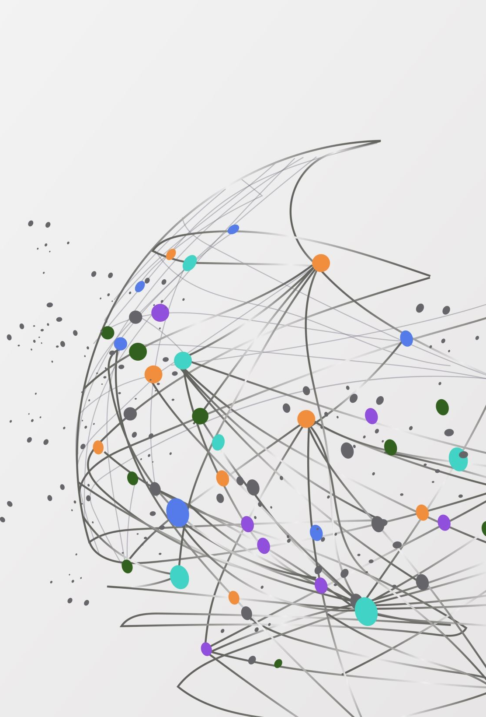
Applications of Stack and Queue

Slide 2
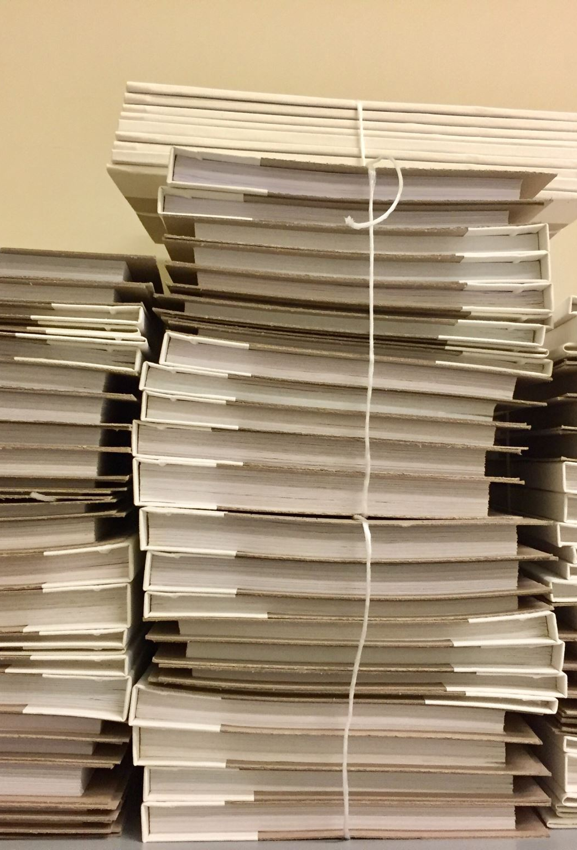
Applications of Stack
Function calls and recursion: When a function is called, the current state of the program is pushed onto the stack. When the function returns, the state is popped from the stack to resume the previous function’s execution.
Undo/Redo operations: The undo-redo feature in various applications uses stacks to keep track of the previous actions. Each time an action is performed, it is pushed onto the stack. To undo the action, the top element of the stack is popped, and the reverse operation is performed.

Slide 3
Applications of Stack
Expression evaluation: Stack data structure is used to evaluate expressions in infix, postfix, and prefix notations. Operators and operands are pushed onto the stack, and operations are performed based on the stack’s top elements.
Browser history: Web browsers use stacks to keep track of the web pages you visit. Each time you visit a new page, the URL is pushed onto the stack, and when you hit the back button, the previous URL is popped from the stack.

Slide 4
Applications of Stack
Balanced Parentheses: Stack data structure is used to check if parentheses are balanced or not. An opening parenthesis is pushed onto the stack, and a closing parenthesis is popped from the stack. If the stack is empty at the end of the expression, the parentheses are balanced. Backtracking Algorithms: The backtracking algorithm uses stacks to keep track of the states of the problem-solving process. The current state is pushed onto the stack, and when the algorithm backtracks, the previous state is popped from the stack.

Slide 5
Applications of queue
Task Scheduling: Queues can be used to schedule tasks based on priority or the order in which they were received.
Resource Allocation: Queues can be used to manage and allocate resources, such as printers or CPU processing time.
Batch Processing: Queues can be used to handle batch processing jobs, such as data analysis or image rendering.

Slide 6
Applications of queue
Message Buffering: Queues can be used to buffer messages in communication systems, such as message queues in messaging systems or buffers in computer networks.
Event Handling: Queues can be used to handle events in event-driven systems, such as GUI applications or simulation systems.
Traffic Management: Queues can be used to manage traffic flow in transportation systems, such as airport control systems or road networks.
Operating systems: Operating systems often use queues to manage processes and resources. For example, a process scheduler might use a queue to manage the order in which processes are executed.
Network protocols: Network protocols like TCP and UDP use queues to manage packets that are transmitted over the network. Queues can help to ensure that packets are delivered in the correct order and at the appropriate rate.

